Slide 1
Fort Bend Junior Service League
Community Impact-Annual Report
2016/2017 League Year

Slide 2
History
In the summer of 2000, a small group of women decided to form a Service Organization to serve those in Fort Bend County who need our help the most.
In January of 2001, with 24 Charter Members, the Fort Bend Junior Service League was officially started.
Since that time, we have volunteered hundreds of thousands of hours! FBJSL has truly made a profoundly positive impact on our community!

Slide 3
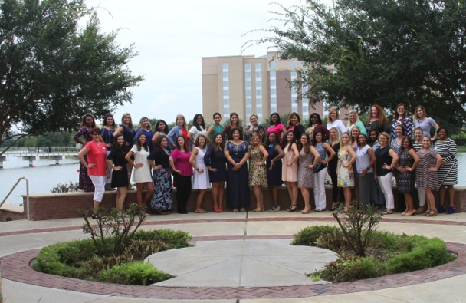
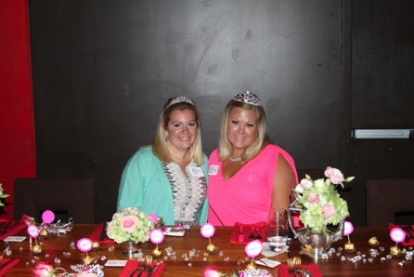
New Member Bruncheon
The year began by welcoming our New Members, and inviting them to “Be the ONE” to make a difference!

Slide 4
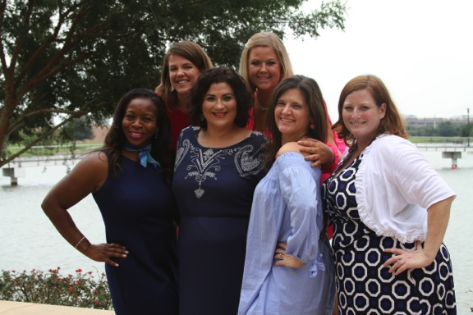
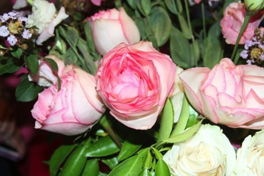
Director of New Members, Jen Rizzo, with her Mentors.
Our New Members are helped through their first year with the League. They are fortunate to have the guidance of our Director of New Members, as well as a Mentor who is specifically assigned to them!

Slide 5
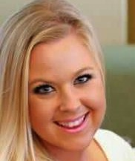
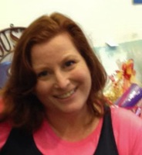
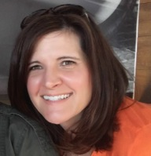
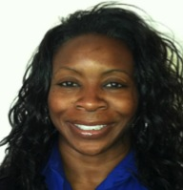
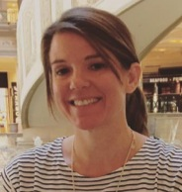
Provisional Mentors – FAB FIVE
Kelsea Lake
Gillian Parker
Katie Parsons
LaQuita Starr
Holly Thompson

Slide 6
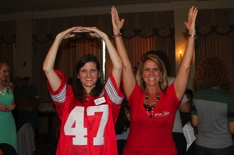
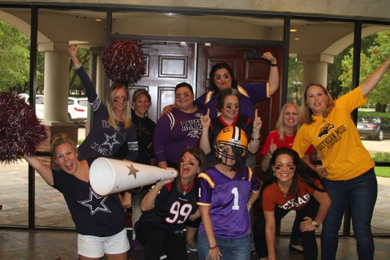
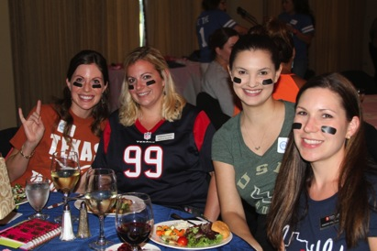
September General Meeting
Our General Meetings are FUN & informative! For our first General Meeting we “KICKED OFF” an amazing start to our year. It was so exciting to see old friends and meet new ones!

Slide 7
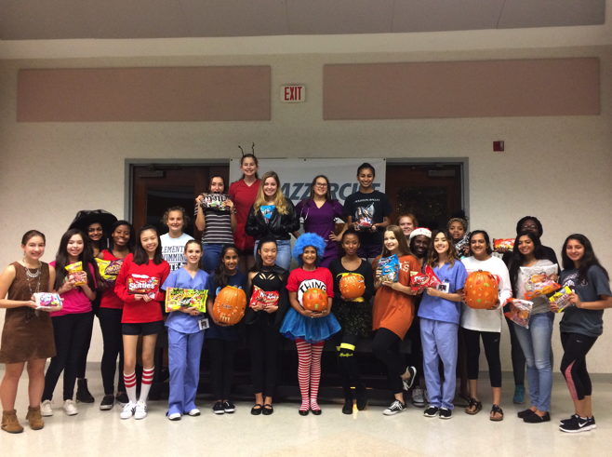
The Teen League and Sustainers “kicked off” an amazing year too.

Slide 8
Volunteer Placements
Some of the Placements our Members can choose to serve include:
Beneficiary Review Committee
Board of Directors
Core Placement Agencies
Sugar Plum Market Committee
Teen League Advisory Committee or Mentor
New Member Mentor
Our goal is that our Members would experience a meaningful volunteer opportunity no matter which placement they choose; not to mention making some friends along the way!

Slide 9
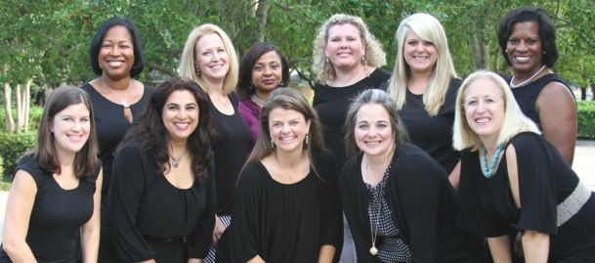
Beneficiary Review Committee (BRC)
These ladies work hard all year, reviewing funding applications from worthy Fort Bend County Charitable Agencies. The 2016-2017 BRC Committee reviewed applications from over 30 agencies and conducted site visits and interviews for each one! They diligently assessed the distribution of proceeds from the Sugar Plum Market, the League’s largest fundraising event. The BRC also carefully evaluated all Community Assistance Fund Applications, AND sifted through many wonderful Scholarship Applications. It is through the diligence of the BRC that we can assure funds are awarded to some amazing organizations and individuals.
From Left to Right: Markisha Venzant-Sampson, Julie Sams, Jenetha Jones, Fallon Moody, Taylor Connor, Tanya Justice
Heather Hernandez, Kavita Self, Laura Taylor, Stacie Janak, Michelle Beeson

Slide 10
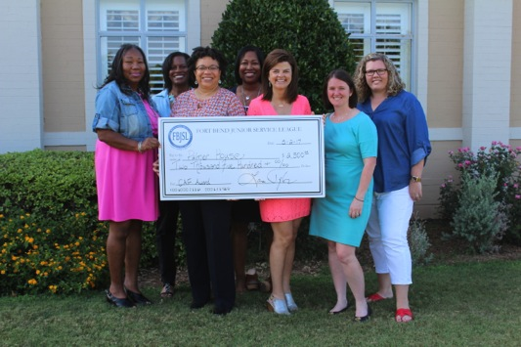
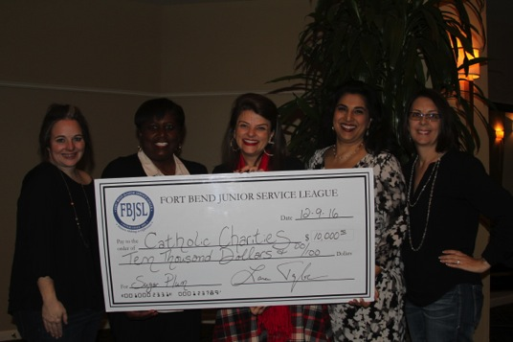
Community Assistance Fund
FBJSL Awarded 8 grants via our Community Assistance Fund, totaling $37,405 during the 2016-2017 League Year.

Slide 11
2017 Scholarship Recipients
FBJSL is thrilled to support wonderful, talented women in their educational pursuits!

Slide 12
Core Placements
During the 2016-2017 League Year we had the privilege of serving 9 Core Placement Agencies.

Slide 13
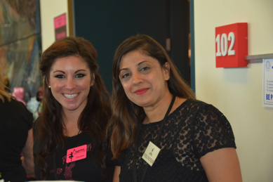
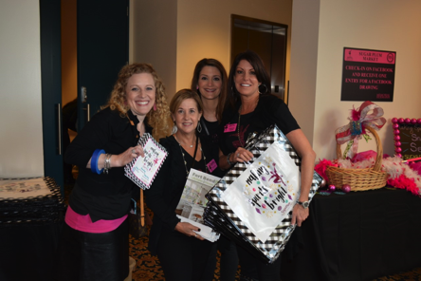
In addition to our Core Placements, our Members also have the opportunity to Volunteer on our largest fundraiser; the Sugar Plum Market. The entire League plays an important part in the Sugar Plum Market! From Actives, to Provisionals; Teen League to Sustainers; we couldn’t do it without each and every Volunteer!

Slide 14
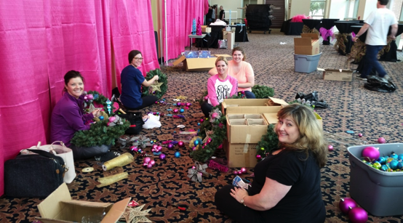
By coming together to work on such a successful event, Sugar Plum Market Committee-members and Volunteers have fun and form friendships!

Slide 15
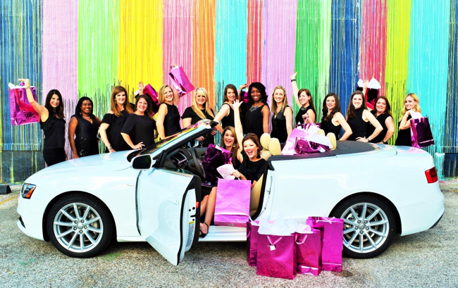
The 2016 Sugar Plum Market raised more money than ever before!

Slide 16
An impressive $310,000 was distributed to 22 different Fort Bend County Agencies; effectively touching thousands of lives in our community; assisting those who need it most.

Slide 17
Just LOOK at all the Agencies we helped!!
Access Health
Fort Bend Women’s Center
The ARC of Fort Bend County
Gigi’s Playhouse
Boys and Girls Club of Greater Houston
Hope For Three
Brookwood Community
Houston Museum of Natural Science at Sugar Land
Catholic Charities
Literacy Council of Fort Bend County
Child Advocates of Fort Bend
Lunches of Love
East Fort Bend Human Needs Ministry
Parks Youth Ranch
Fort Bend Family Promise
SIRE
Fort Bend Habitat for Humanity
Texana Center
Fort Bend Rainbow Room
The First Tee
Fort Bend Seniors
The Rose
FBJSL’s Community Assistance Fund

Slide 18
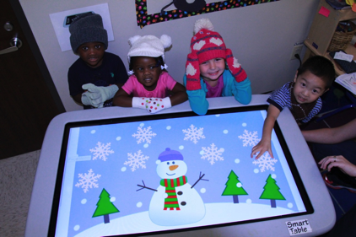
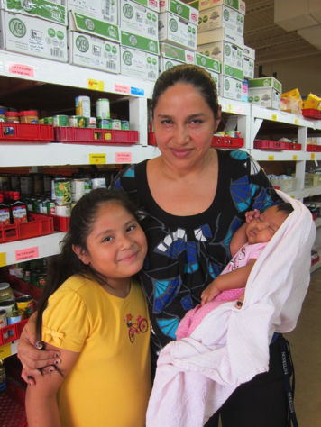
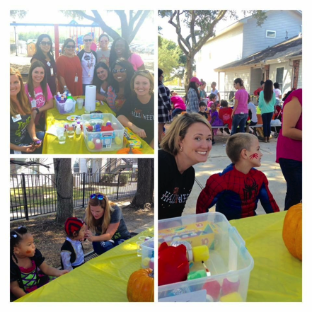
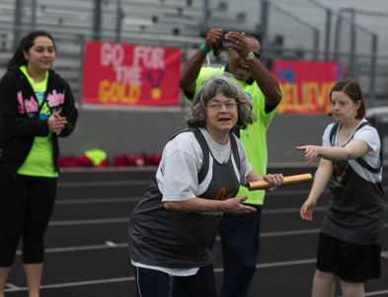

Slide 19
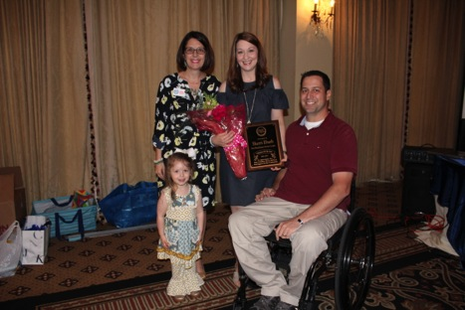
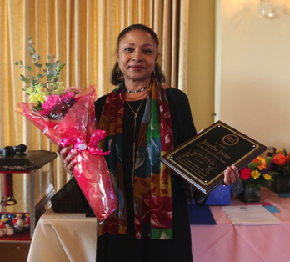
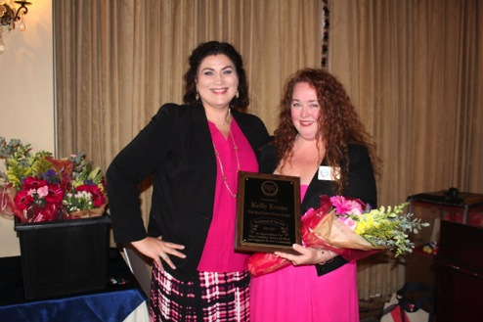
The end to an amazing year was capped off by recognizing some of our hardest-working Volunteers!
Sustainer of the Year: Jenetha Jones
Provisional of The Year: Kelly Evans with Director of New Members, Jen Rizzo
Volunteer of the Year:
Sherri Ebarb with her family and Past President, Dana Clement

Slide 20
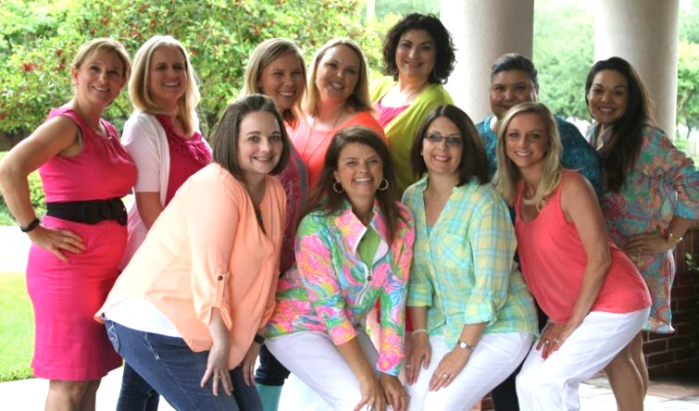
LOOK how far we’ve come!
2016-2017 FBJSL Board of Directors
From Left to Right: Sher Schuele, Angela Parker, Tara Kuykendall, Jennifer Gottlieb, Consuelo Haller, JJ Phillips, Stacie Janak, Laura Taylor, Dana Clement, Emily Calbert

Slide 21
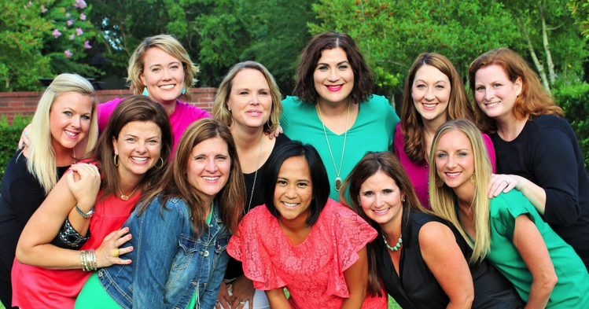
Be the “ONE” to make a difference! Come join us!! FBJSL.org
2017-2018 FBJSL Board of Directors
From Left to Right: Kelsea Lake, Emily Rhodes, Jennifer Gottlieb, Jen Rizzo, Sherri Ebarb, Gillian Parker, Laura Taylor, Katie Parsons, Susan Correa, Colleen Fox, Emily Calbert

Slide 22
Fort Bend Junior Service League
Women Making a Difference

